Slide 1
CS4132 Project Presentation
Russell ng

Slide 2
Overview
Aim
Results & findings
Conclusions & recommendations
Limitations & future work

Slide 3
aim
To investigate Singapore’s progress towards achieving certain SDGs
To investigate possible solutions in other countries that may be relevant in Singapore
To investigate whether we are on track to meet our own specific SDGs
To investigate possible areas we may focus on in the future

Slide 4
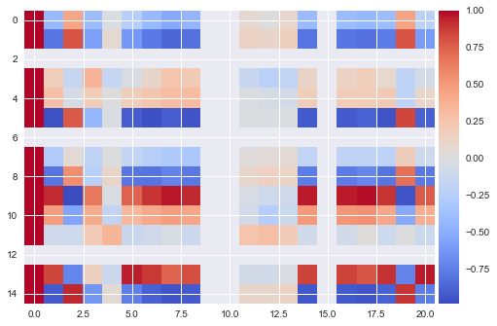
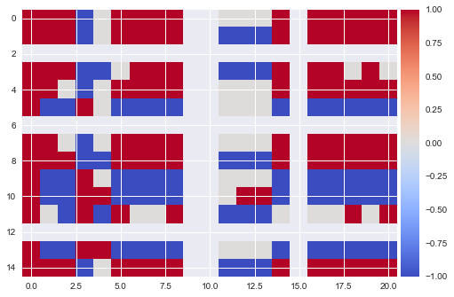
Results & findings

Slide 5
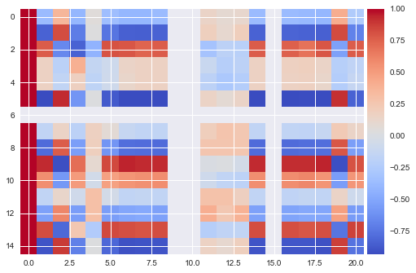
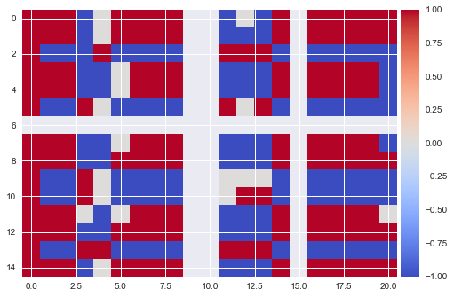
Results & findings

Slide 6
Results & findings
Based on the heatmap, we conclude that the areas of greatest improvement for singapore are
[indicator name, unit (number of unsustainable indicators)]:
Greenhouse gas emissions, kt (13/20)
Forest area, % (12/20)
Electrical power consumption per capita, kwh (12/20)
Oil consumption per capita, tonnes (12/20)
Annual mean temperature, degc (12/20)

Slide 7
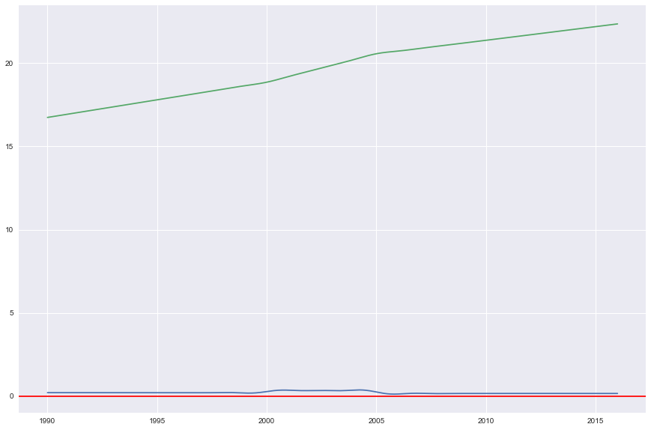
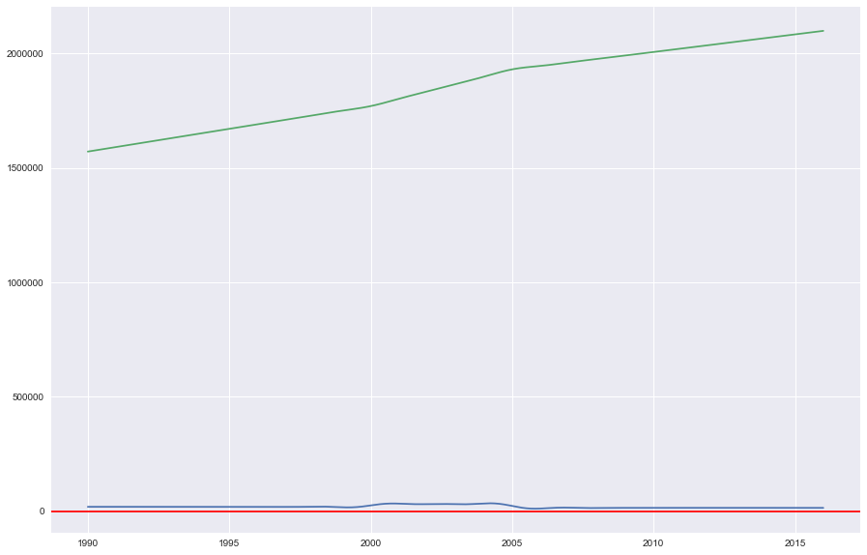
Results & findings
China, Left: Forest area, km2; Right: Forest area, %

Slide 8
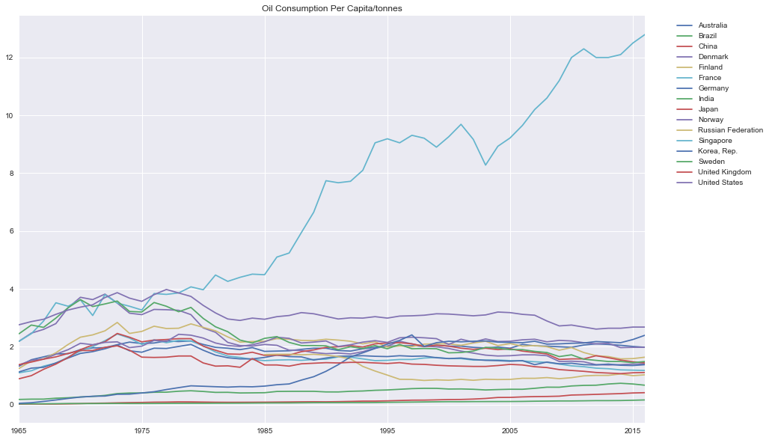
Results & findings

Slide 9
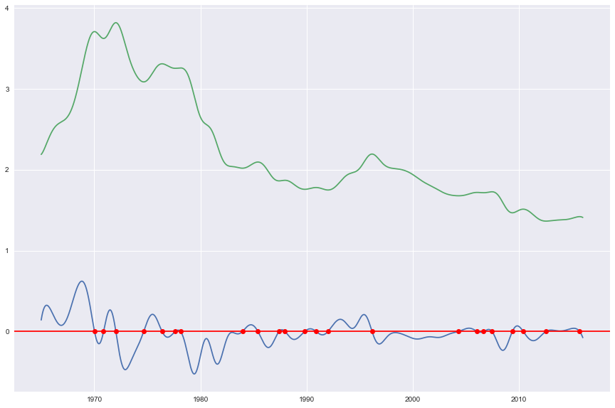
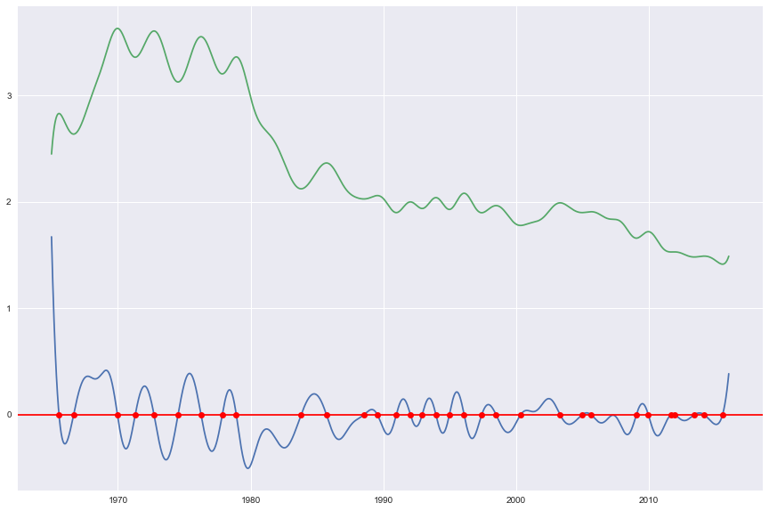
Results & findings
Right: Oil consumption, Denmark; Left: Oil consumption, Sweden

Slide 10
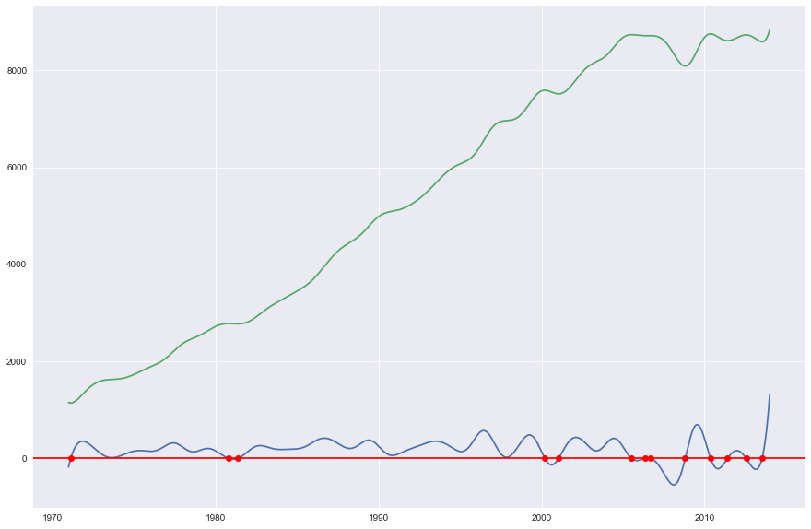
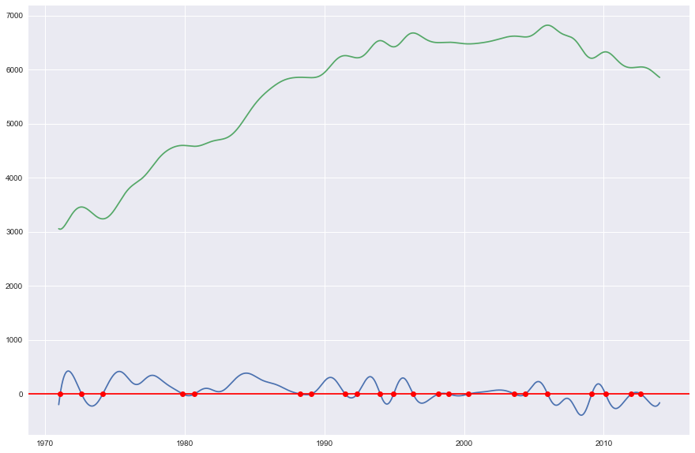
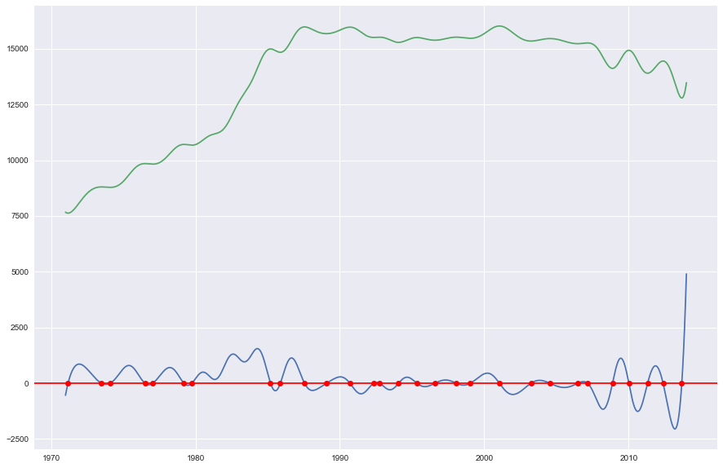
Results & findings
Electrical consumption, Left: SG; Center: Denmark; Right: Sweden

Slide 11
Results & findings
Reduce greenhouse gas emissions by 16% from business-as-usual (BAU) levels by 2020, effective 2008, [Kyoto protocol, UN framework convention on climate change]
Reduce greenhouse gas emission intensity by 36% from 2005 levels by 2030

Slide 12
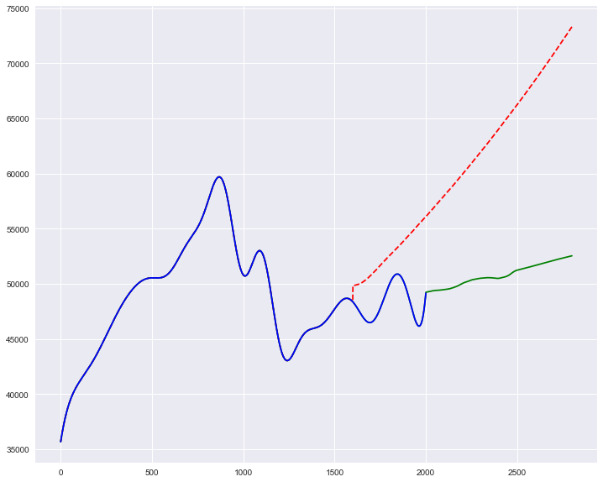
Results & findings
GHG emissions from 1992 (reference point 0 on x-axis) to 2012 (blue), predicted BAU emissions from 2008 (red dotted), predicted emissions from 2012 onward (green); x-axis scale is 100:1 year

Slide 13
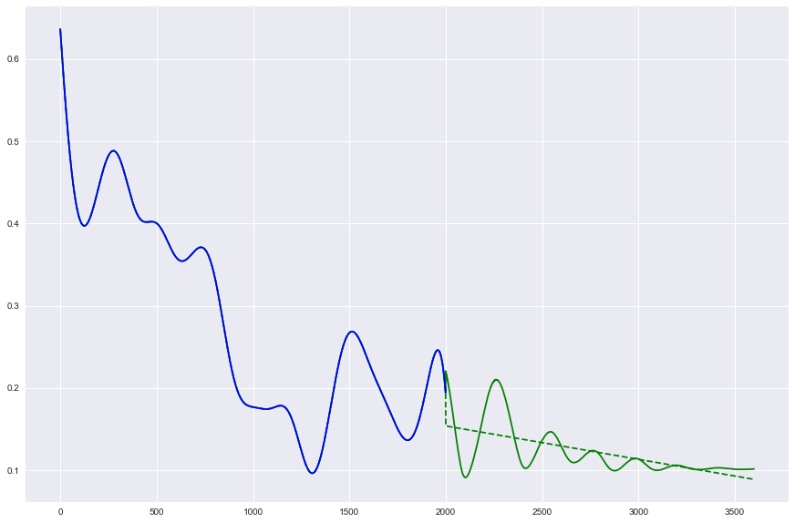
Results & findings
GHG emission intensity from 1994 (reference point 0 on x-axis) to 2014 (blue), predicted GHG emission intensity from 2015 onwards (green), linear regression of predicted values from 2015 onward (green dotted); x-axis scale is 100:1 year

Slide 14
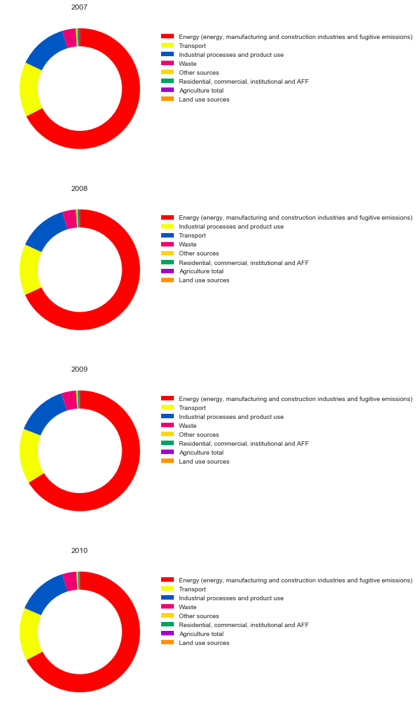
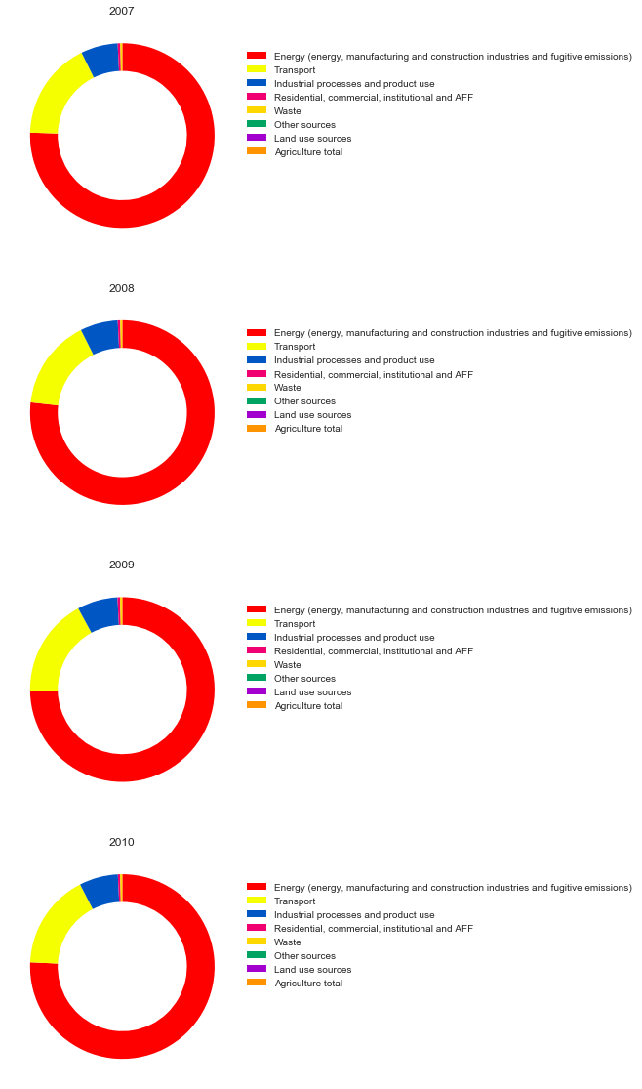
Results & findings
Donut plot of SG GHG (Left) and CO2 (Right) emissions, 2007-2010

Slide 15
Conclusions & recommendations
Forest area: To follow China’s and Denmark’s example
- China: Grain-for-Green policy, National Reforestation Plan
- Denmark: Danish Forest Act, Telethon to raise funds for reforestation
- Set aside fixed amount of land that must be reforested

Slide 16
Conclusions & recommendations
For annual mean temperature: a mix of various factors
Should follow Denmark’s example:
- Switching over from non-renewable sources (coal, oil, gas) to renewable sources (hydroelectric, wind [in Denmark’s case])
- Provide incentives for companies that go green
- Develop new eco-friendly technology

Slide 17
Limitations & future work
LSTM model might not have been the best model; should have tried Monte Carlo simulation
Hyperparameters may not be optimized
Indicators chosen are within a quite narrow range, and many are related or are in similar categories, due to unavailability of a wide range of indicators
Extending the above project not just to Singapore but to other countries around the world
Incorporating a wider range of sustainability and development factors.

Slide 18
References/data sources
0: https://data.worldbank.org/indicator/EN.ATM.CO2E.KT
1: https://data.worldbank.org/indicator/EN.ATM.CO2E.PC
2: https://data.worldbank.org/indicator/EN.ATM.GHGT.KT.CE
3: https://data.worldbank.org/indicator/SP.DYN.LE00.IN
4: https://data.worldbank.org/indicator/EG.FEC.RNEW.ZS
5: https://data.worldbank.org/indicator/EG.ELC.RNEW.ZS
6: https://data.worldbank.org/indicator/SP.DYN.IMRT.IN
7: https://data.worldbank.org/indicator/SL.UEM.TOTL.ZS
8: https://data.worldbank.org/indicator/NY.GDP.PCAP.KD.ZG
9: https://data.worldbank.org/indicator/NY.GDP.PCAP.CD

Slide 19
References/data sources
10: https://data.worldbank.org/indicator/NY.GDP.PCAP.PP.CD
11: https://data.worldbank.org/indicator/IT.NET.USER.ZS
12: https://data.worldbank.org/indicator/IT.CEL.SETS.P2
13: https://data.worldbank.org/indicator/SH.STA.SMSS.ZS
14: https://data.worldbank.org/indicator/SH.H2O.SMDW.ZS
15: https://data.worldbank.org/indicator/NY.GNP.PCAP.KD.ZG
16: https://data.worldbank.org/indicator/NY.GDP.MKTP.KD.ZG
17: https://data.worldbank.org/indicator/AG.LND.FRST.ZS
18: https://data.worldbank.org/indicator/AG.LND.FRST.K2
19: https://data.worldbank.org/indicator/NY.GNP.MKTP.KD.ZG

Slide 20
References/data sources
20: https://data.worldbank.org/indicator/EG.ELC.FOSL.ZS
21: https://data.worldbank.org/indicator/EG.USE.COMM.FO.ZS
22: https://data.worldbank.org/indicator/EG.USE.ELEC.KH.PC
23: https://ourworldindata.org/human-development-index
24: https://www.kaggle.com/akul27/average-temperature-per-country-per-year/data
25: https://data.worldbank.org/indicator/EG.ELC.ACCS.ZS
26: https://data.worldbank.org/indicator/EG.USE.PCAP.KG.OE
27: https://www.gapminder.org/data/
28: https://www.gapminder.org/data/
29: http://hdr.undp.org/sites/default/files/2018_all_indicators.xlsx

Slide 21
References/data sources
30: http://hdr.undp.org/sites/default/files/2018_all_indicators.xlsx
31: https://data.worldbank.org/indicator/NY.GNP.PCAP.PP.CD
32: https://data.worldbank.org/indicator/VC.IHR.PSRC.P5
33: https://data.worldbank.org/indicator/NY.GNP.PCAP.CD
34: https://data.worldbank.org/indicator/EN.ATM.CO2E.KD.GD
35: https://knoema.com/atlas/Singapore/CO2-emissions
36: https://knoema.com/atlas/Singapore/topics/Environment/Emissions/Methane-emissions
37: https://knoema.com/atlas/Singapore/topics/Environment/Emissions/Nitrous-oxide-emissions
38: http://www.fao.org/faostat/en/#data/EM

Slide 22
Thank you

